Slide 1

Which news is fake?
Project 4
Metis Data Science Bootcamp
By Ouyang Yingzhao
Photo by Max Muselmann on Unsplash

Slide 2

Why should we care?
In the US:
Over half claim to regularly see fake news on sites such as Facebook or Twitter.
Over a quarter rarely trusted the news that they read on social media
14 percent said that they have deliberately shared a fake political news story online
Source: Fake News - Statistics & Facts by Amy Watson on Staista, May 5 2020
Image by S. Hermann & F. Richter from Pixabay

Slide 3
Objectives
Based on features derived from a fake news dataset...
…predict which piece of news is fake

Slide 4
Methodology
Data retrieval
EDA
Feature selection
Modelling

Slide 5
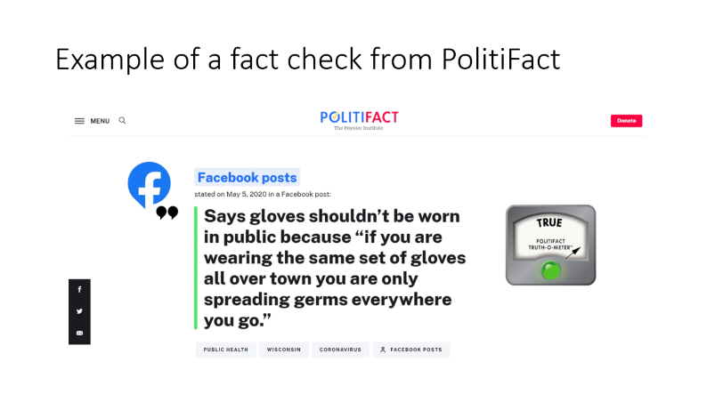
Downloaded LIAR dataset
Background
Retrieved from the PolitiFact.com API
Statement dates primarily between 2007 and 2016
Source: Yang, 2017

Slide 6
LIAR data files
Pre-split into train, validation and test
Workflow:
Perform 5-fold cross-validation on train dataset
Choose models based on validation dataset
Use test dataset on final model
This is to guard against over-fitting
File | Statements
train.tsv | 10,240
valid.tsv | 1,284
test.tsv | 1,267

Slide 7

Retrieved features
Column(s) | Description
id | The json ID of the statement
label | Truth value of the statement; 6 categories from ‘true’ to ‘pants on fire’
statement | Title of the PolitiFact article, often but not always the actual statement
subject | The subject(s) of the statement
speaker | The source of the statement
speaker_job speaker_us_state speaker_affiliation | The speaker’s job title, US state where they’re based, and party affiliation, where available
speaker_bt … speaker_pof (5 features) | Total count of truth values for the speaker (truth credit history), excluding ‘true’ count and including the current statement
context | The context (venue / location of the speech or statement)
Target feature is ‘label’
Ignoring truth credit history as features
Future knowledge would be included – big no-no
Need dates tagged to each statement to do a proper time-series analysis
via

Slide 8
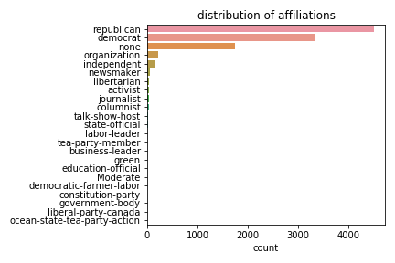

Speaker affiliations are mostly republican, democrat or none
19 other minor affiliations
Visualised with

Slide 9
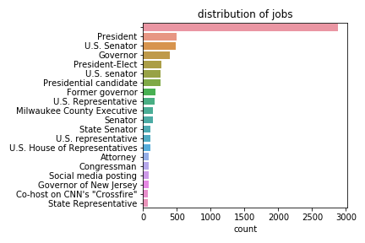
Lots of speaker jobs…
… 1,185 speaker jobs tagged for 2,910 unique speakers to be exact
However, 2,878 statements are tagged to ‘blank’ speaker jobs
More than a quarter of the dataset!

Slide 10
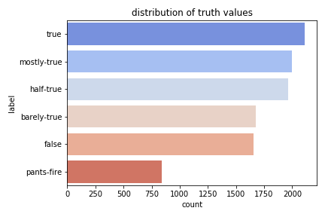
Truth values skew toward ‘true’ and ‘mostly-true’

Slide 11
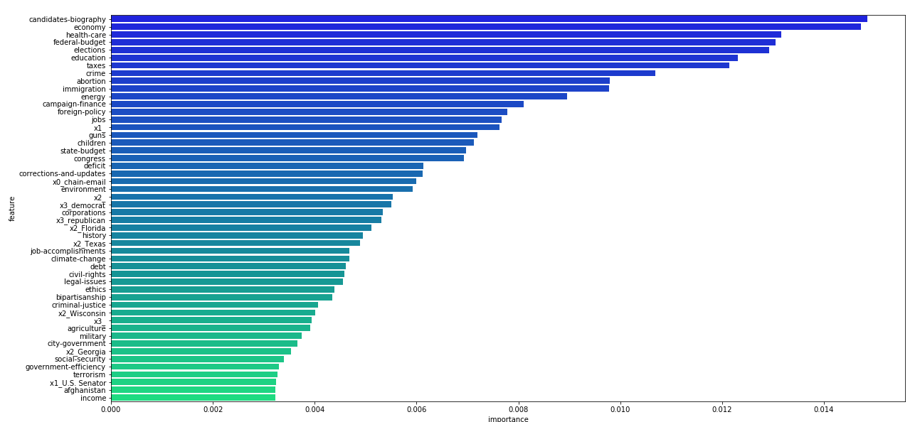
‘subject’ is the most important feature

Slide 12



Topic Modelling
Model statement, context and speaker_job…
…so as to cluster the three features into similar groupings
Click the icon for methodology

Slide 13
Features and targets considered
 | speaker_affiliation | speaker_job | subject | context | label
Original feature | X | X | X |  | X
Subset of feature |  |  | 20 most common, 20 most important |  | Transformed to ‘true’ and ‘false’ only
Topic modelling |  | X | Based on statement | X
Types of features considered
Features and targets selected
Types of targets considered

Slide 14

Models considered
Random Forest
Randomized search (20 iterations)
Multinomial Naïve Bayes
Grid search
Gradient Boosting
Randomized search (20 interation)
Selected

Slide 15
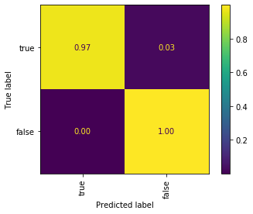
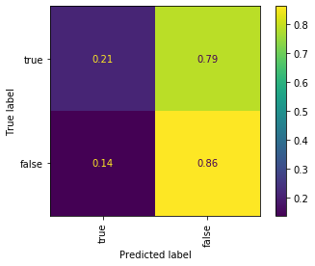
Final model
Train
Best model
Random Forest
f1 score on train dataset
0.58
Evaluation

Slide 16
Future work
Supplement with other fake news datasets or API’s
Apply different models e.g. recurrent neural networks

Slide 17

To contact me:
Yingzhao Ouyang
Data Scientist
https://www.linkedin.com/yzouyang
https://www.medium.com/@yzouyang

Slide 18
Appendix

Slide 19

Topic modelling: methodology
For statement:
Non-Negative Factorization (20 or 50 topics) using:
Count Vectorizing with words only
Count Vectorizing with words and bigrams
TF-IDF Vectorizing with words only
For context and speaker_job:
Non-Negative Factorization (20 or 50 topics) using:
TF-IDF Vectorizing with words and bigrams
Combined and seperately:
Document embedding using:
Stanford’s GloVe
Selected

Slide 20
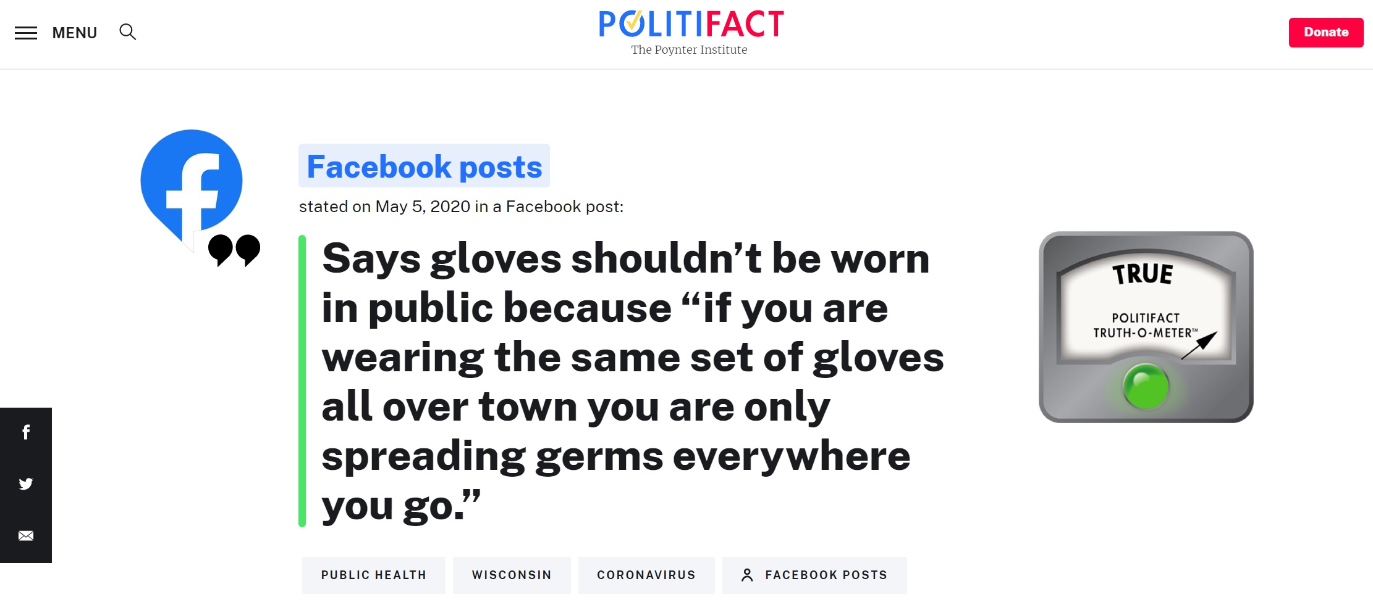
Example of a fact check from PolitiFact

Slide 23
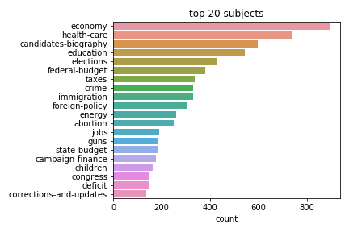

Slide 26
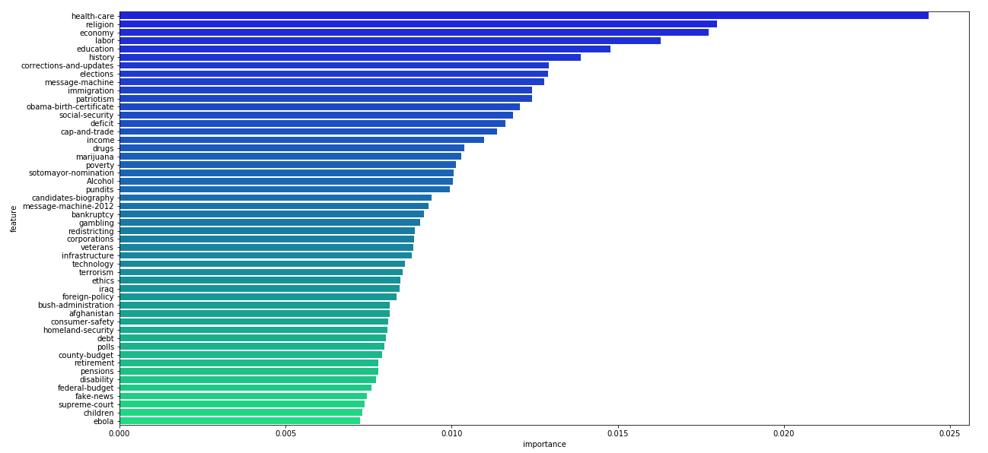

Slide 27
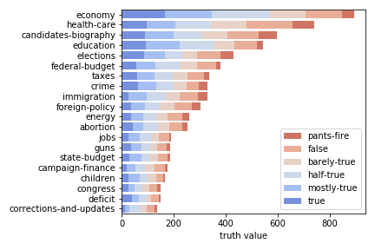

Slide 28
